Slide 1
Humans and Sustainability The environment and Sustainability
Objectives
--Understand why environmental problems are complex and interrelated.
-- Realize that environmental problems involve social, ethical, political and economic issues, not just scientific issues.
-- Understand that acceptable solutions to environmental problems often are not easy to achieve.
-- Understand that all organisms have an impact on their surroundings.

Slide 2
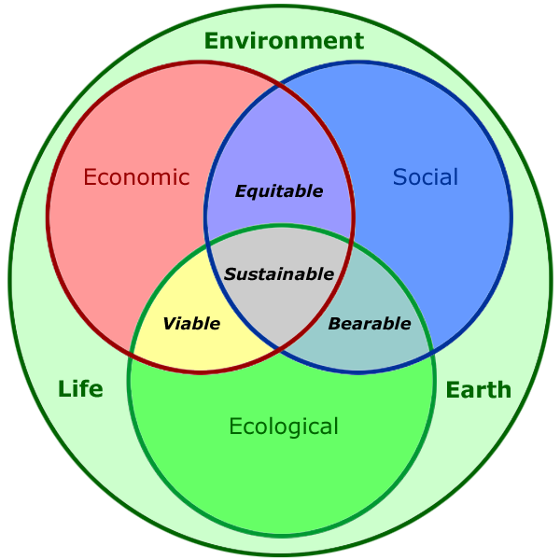
Human and Sustainability

Slide 3
Principles of Sustainability
Environmental Science is a Study of Connections in Nature
Environment → everything that affects an organism during it’s lifetime.
all organisms including living things and non living things interact with each other.

Slide 4
Environment includes
1. energy
2. living things
3. non living things
4. humankind’s – many scientific & technological advances
5. lives depend on – sunlight, the earth for clean air and water, food, energy, fertile soil, climate and other components of the planet’s life-support system.

Slide 5
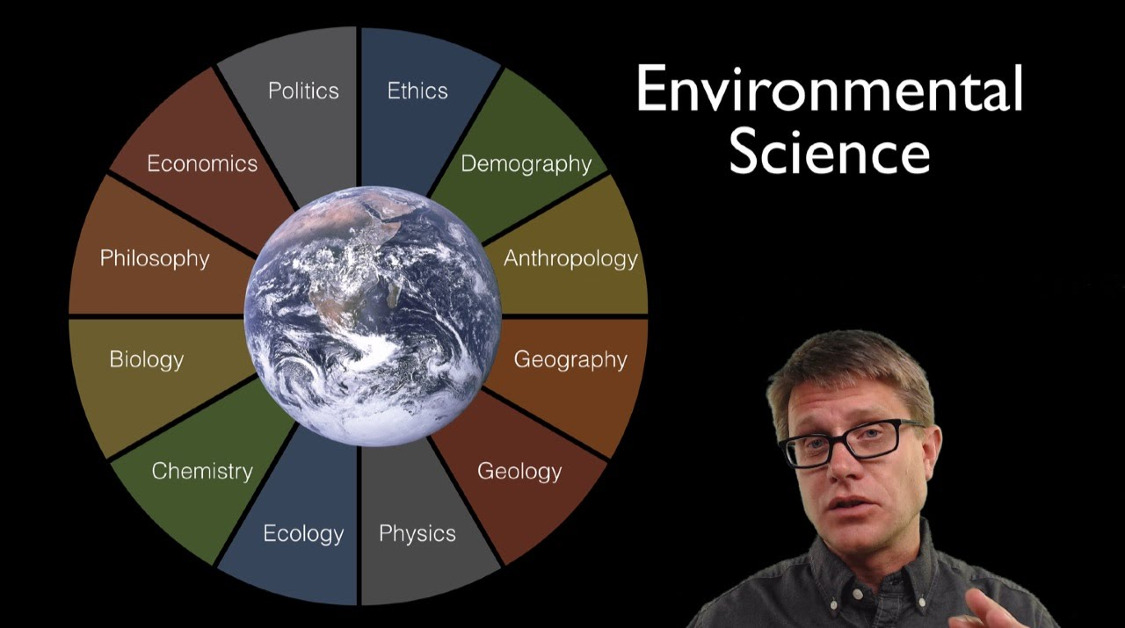

Slide 6
Environmental science
study of life connections in the natural environmental.
An interdisciplinary study of….
1. how the earth works and has survived and thrived
2. how human interact with the environment
3. how human can live more sustainably

Slide 7
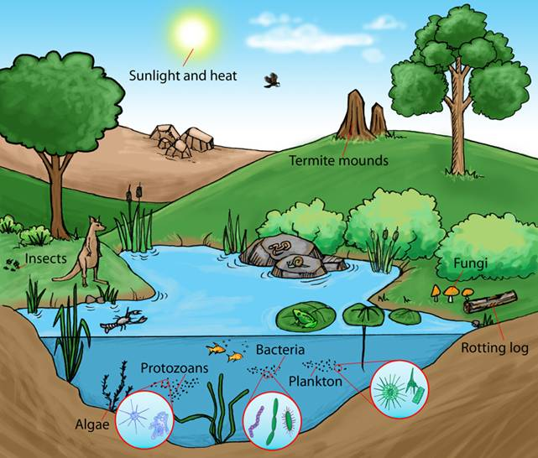
Ecosystem

Slide 8
Ecology
A key component of environmental science is Ecology.
Branch of biology that focuses on how living organisms interact with living and non living parts of their environment.

Slide 9
Ecosystem
biological community of organisms within an area of land or volume of water that interact with one another and with the nonliving chemical and physical factors in their environment.
e.g: forest ecosystem consists of plant, animals and organisms that decompose organic materials, all interacting with one another and the chemicals in the forest’s air, water, and soil.

Slide 10
Principles of Sustainability
(1) Solar energy : - sun’s energy warms the planet and provides energy that plant use to produce nutrients.
Chemicals that plants and animals need to survive.
(2) Biodiversity : the variety of genes, species ecosystems and ecosystem processes.
Interactions among species provide vital ecosystem services and keep any population from growing too large.
Biodiversity provide
→ species to adapt to changing environmental condition
→ new species to arise
→replace those wipe out by catastrophic environmental changes

Slide 11
(3) Chemical cycling or Nutrient cycling :
→the circulation of nutrients from the environment through various organisms and back to the environment.
The earth receives energy from the sun but it receives no new supplies of life supporting chemical.
interactions with their living and nonliving environment.
organisms have developed ways to recycle the chemicals they need to survive.
→ water and decayed bodies of organisms become nutrients for other organisms

Slide 12
Three additional principles of sustainability
1) Full cost pricing → economics find the ways to include : market prices for harmful environmental and health costs of producing and using good and services.
Give consumers information
2) Win win solution→ political scientists urge us to look for win win solution to environmental problems
Base on cooperation and compromise,
Benefit for people and environment

Slide 13
3) Responsibility to future generation( Ethics)
Branch of philosophy
According to environmental ethicists: we have a responsibility to leave the planet’s
Life support system in condition as good as
Better than what we inherited for the benefit of future generations and for other species.

Slide 14
Environmental worldviews
Ethics and sustainability
reason why environmental problems persists is that people differ over the nature and environmental problems as well as how to solve.
Set assumptions and values about how the natural world works and how you think you should interact with the environment.
It’s determined partly by your environmental ethics.
What you believe about
What is right and what is wrong

Slide 15
Three major categories of environmental worldviews:
1) human center
human life.
Two variations :
1) planetary management worldview
2) stewardship worldview
Both hold that humans are separate from and in charge of nature and that society should manage the earth for the benefit of humans.
If we degrade a natural resource, can use our ecological ingenuity to find a substitute.
- Stewardship add → people have a responsibility to be caring and stewards of the planet for current and future human generation.

Slide 16
(2) Life center
species life
All species have value of their ecological roles, regardless of their potential
Species become extinct.
Most people with the life centered worldview believe
We ought to avoid hastening the extinction of species through human activities
Because each species is a unique part if the biosphere that sustain all life.

Slide 17
(3) Earth centered
people are part of or dependent on nature and the earth’s natural capital exists for all species.
Not just for human
Economic success and long turn survival of our cultures, species and other species depend on learning how life on the earth has sustained itself for many years.

